Slide 1
Unit 2
EXPONENT LAWS

Slide 2
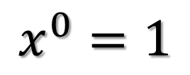
Zero as an Exponent
A number to the exponent of 0 is always 1
Examples
$${(−5.9)}^{0}=1$$
$${123}^{0}=1$$
$$x^{0}=1$$

Slide 3
Negative Exponents
You Cannot Have a Negative Exponent
If you do, and it is in the numerator of the fraction, bring it to the denominator and make the exponent positive. (From top to bottom)
If it is in the denominator, bring it to the numerator and change it to a positive. (From bottom to top)

Slide 4
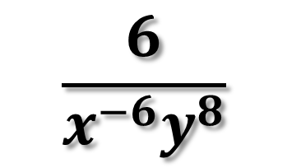
Simplify the Expression
$${(−6.8)}^{0}$$
$${(−2)}^{−3}$$
$$\frac{6}{x^{−6}y^{8}}$$
$${10}^{−2}∙{14}^{0}$$

Slide 5
Multiplication Rule for Exponents
When Multiplying 2 Numbers with the Same Bases, Keep the Base and Add the Exponent
$$j^{4}∙j^{3}$$
$$a^{4}∙{3b}^{8}∙{2a}^{5}$$
$$2^{3}∙2^{2}∙2^{5}$$

Slide 6
Simplify the Expression
$${10}^{6}∙3^{6}$$
$$5^{3}∙7^{3}$$

Slide 7
Power to Power
When you have a Power to a Power, Multiply the Exponents
$${{(k}^{2})}^{7}$$
$${{(x}^{6})}^{−2}$$
$${{(2q}^{5})}^{4}$$

Slide 8
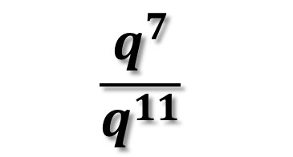
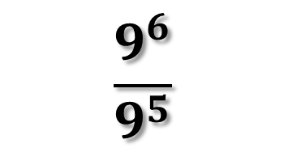
Division Rule for Exponents
When Divide 2 Numbers with the Same Base, Subtract the Exponents
$$\frac{9^{6}}{9^{5}}$$
$$\frac{q^{7}}{q^{11}}$$

